Slide 1
Chiral dynamics in hard processes
M.V.Polyakov
http://www.tp2.rub.de/~maximp
Ruhr-University Bochum
Chiral symmetry breaking - the phenomenon shaping our World
New soft pion theorems in hard processes– how ChSB works for colour clusters
Data: present & possibilities to discover new chiral phenomena @ PANDA

Slide 2
QCD & chiral symmetry
Contains all strong interaction phenomena
Transmutation of dimension: scale
is given not by quark masses but
Symmetries:
But:

Slide 3
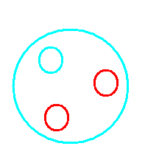
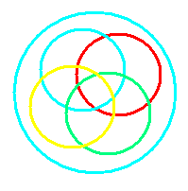
Chiral symmetry is broken spontaneosly
Nambu, Nobel Prize 2008
One of puzzles: Why nucleon looks like
not like
To solve this and other puzzles one has to understand mechanisms of ChSB in QCD.
As important as understanding of confinement!

Slide 4
Due to spontaneous chiral symmetry breakdown: 95% mass of the nucleon is generated→ 95 % mass of visible Universe!
Chiral symmetry is broken spontaneously that is why:
Protons and neutrons exist and are massive
Pions are light
Nuclei exist
... We are here and can study strong interactions @ FAIR
Spontaneous breakdown of chiral symmetry really shapes our world!

Slide 5
Up to now ChSB phenomenon has been studied only in soft processes and it was never studied at the level of quark and gluon degrees of freedom.
Main idea of soft pion theorems is in the following equation:
generator of broken subgroup

Slide 6
computable by symmetry
transformation

Slide 7
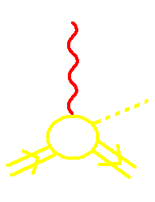
Pion production near threshold
Pion is a (pseudo) Nambu-Goldstone Boson of SBChS => soft pion theorem
/Nambu, Lurie ’62
Nambu, Shraumer ’62/
These ideas created a new direction:
ChPT. Note however that the fundamental d.o.f. Of QCD are not involved!

Slide 8
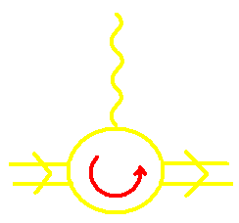
- chirally rotated e.m. current
=> related to axial FF
Example:

Slide 9
Would be breakthrough if here we would have a well defined cluster of quarks and gluons! Would allow to connect ChSB with fundamendal d.o.f. of QCD! Big potential for discovery of new phenomena and understanding of mechanisms of “world shaping phenomenon” in QCD.

Slide 10
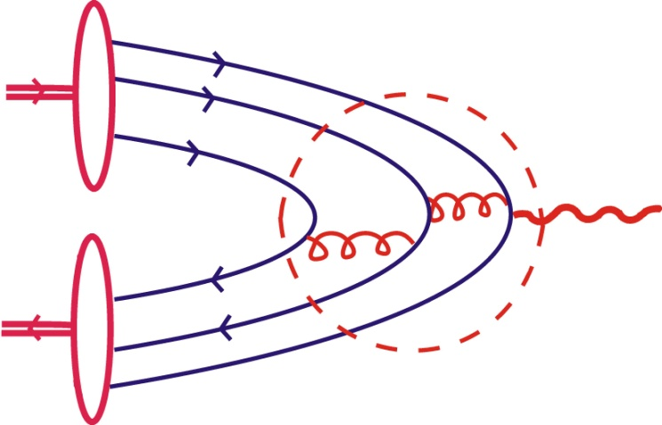
In the limit of Nucleon FF‘s are described in terms of partons-clusters of quarks
hard interactions
=>pQCD
Nucleon
Light-cone WF
Filtering out the lowest Fock component of the hadron‘s WF
/S. Brodsky, P. Lepage/
/Efremov, Radyushkin/

Slide 11
LC WF of nucleon
LC WF of πN system

Slide 12
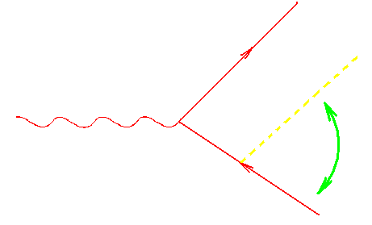
For NS theorem to work the pion should soft relative to all hadrons!
the pion is not soft relative to
initial nucleon

Slide 13
Higher twists (1/Q² supressed) –suppression of initial Nambu-Goldstone immision!

Slide 14
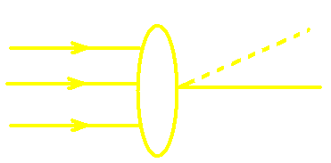
What are πN WF’s when π is near threshold?
Connected by chiral rotation
Simple algebra!

Slide 15
New theorem = “1/2”of NS theorem
For new SPTh important that QCD is a gauge theory!

Slide 16
Comparison
What about data?

Slide 17
/P.Bosted etal. ’94/
but the coefficient is given by different combinations of FF’s of nucleon

Slide 18
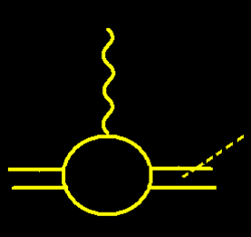
E136 experiment /Bosted et al ‘94/

Slide 19
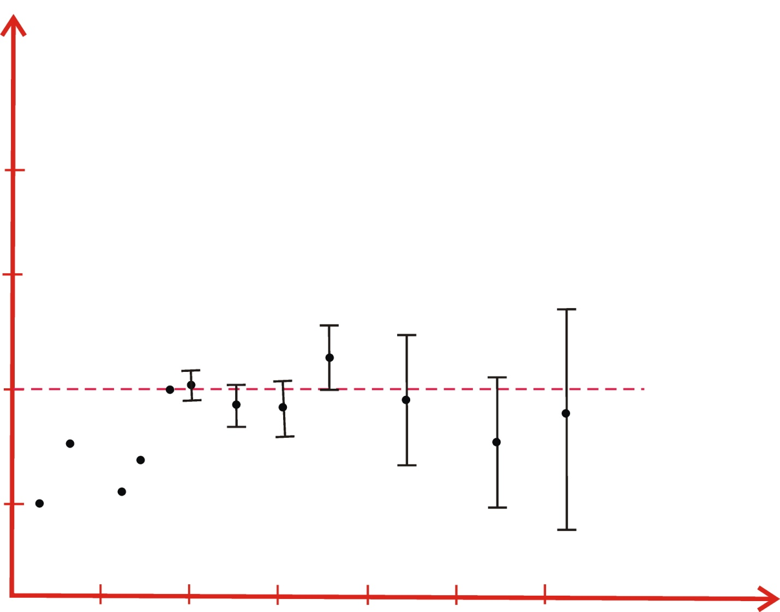
0.20
0.15
0.10
0.05
5 10 15 20 25 30
Q²

Slide 20
Nucleon FF’s from experiment

Slide 21
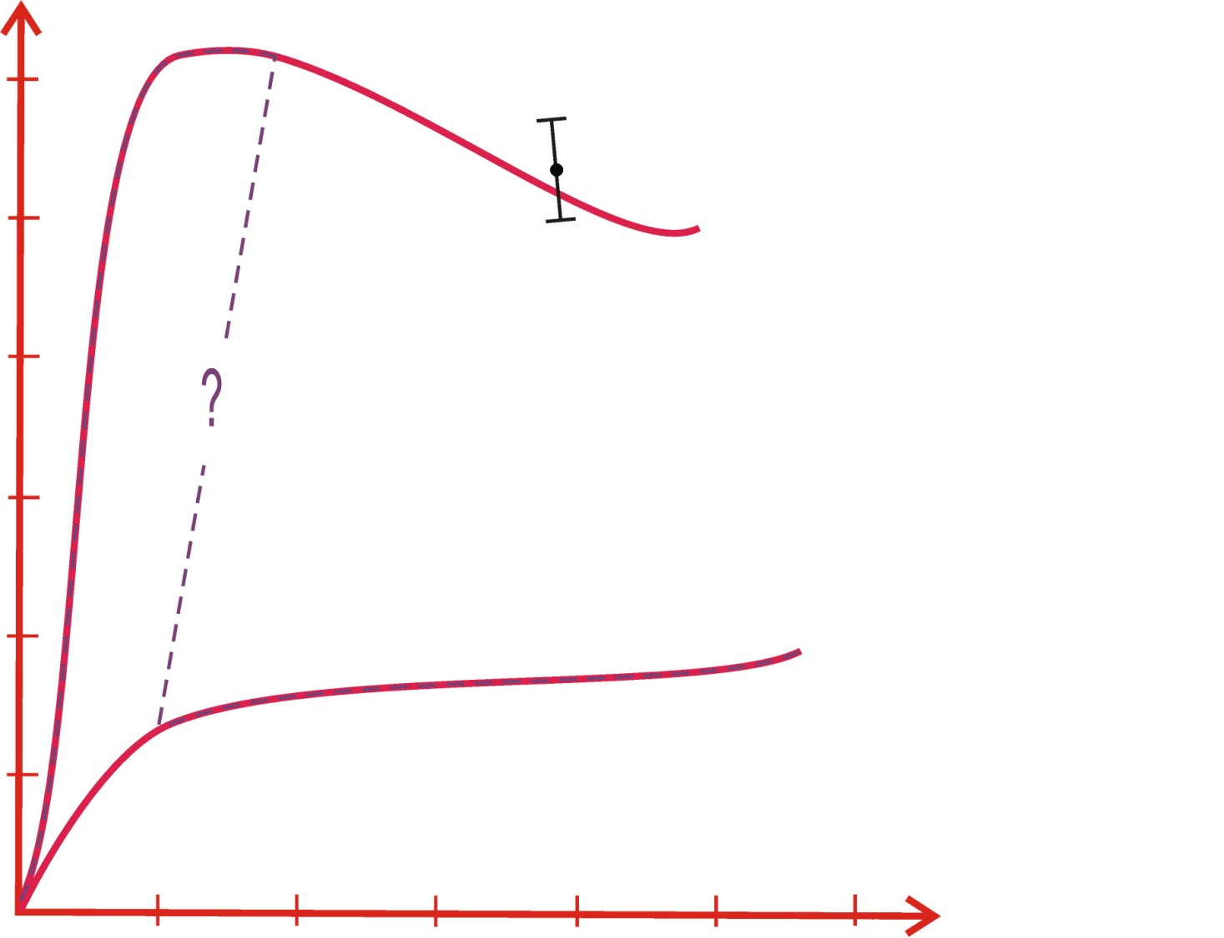
… ? … very interesting domain Transition
from one type of SPTh to another one
0.12
0.10
0.08
0.06
0.04
0.02
E136 point
Ν S
Q²~Λ³/m_{π}
5 10 15 20 25 30
Q²

Slide 22
Opportunities for PANDA

Slide 23
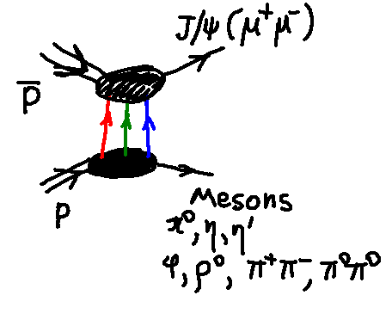
Frankfurt, Strikman, MVP `98
Lansberg, Pire, Szymanowski `07
Soft relative to the proton
Direct mesurement of 5+ quark component of nucleon WF
Measuring different mesons we probe different components of nucleon WF
If here is a pion, eta (gluon rich) → chiral dynamics and anomaly for 5 quark cluster
Possibility to figure out how the chiral symmetry is restored

